Slide 1





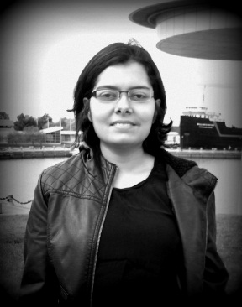




EmojiNet: An Open Service and API for Emoji Sense Discovery
Presented at the 11th International AAAI Conference on Web and Social Media (ICWSM 2017)
Montreal, Canada, 15th – 18th May, 2017
Sanjaya Wijeratne
sanjaya@knoesis.org
Lakshika Balasuriya
lakshika@knoesis.org
Amit Sheth
amit@knoesis.org
Derek Doran
derek@knoesis.org
Ohio Center of Excellence in Knowledge-enabled Computing (Kno.e.sis)
Wright State University, Dayton, OH, USA

Slide 2




What does this emoji mean

Slide 3
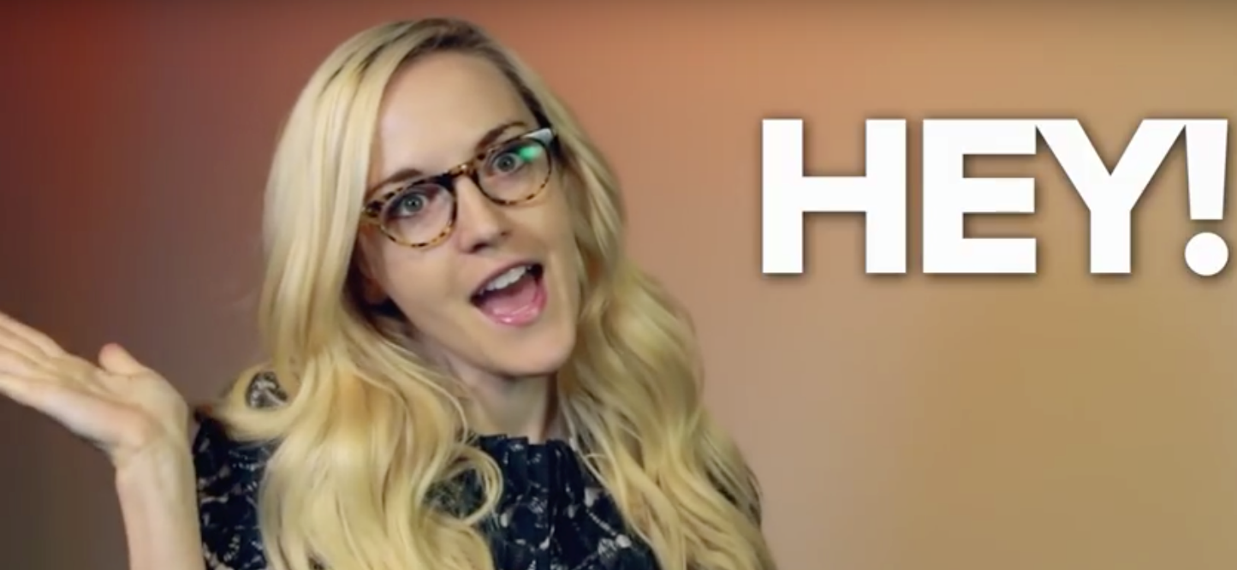
What does this emoji mean
Source – https://youtu.be/5JdVsbNqYno

Slide 4

What does this emoji mean
Source – https://youtu.be/5JdVsbNqYno

Slide 5
What does this emoji mean
U+1F481 INFORMATION DESK PERSON

Slide 6

What does this emoji mean

Slide 7
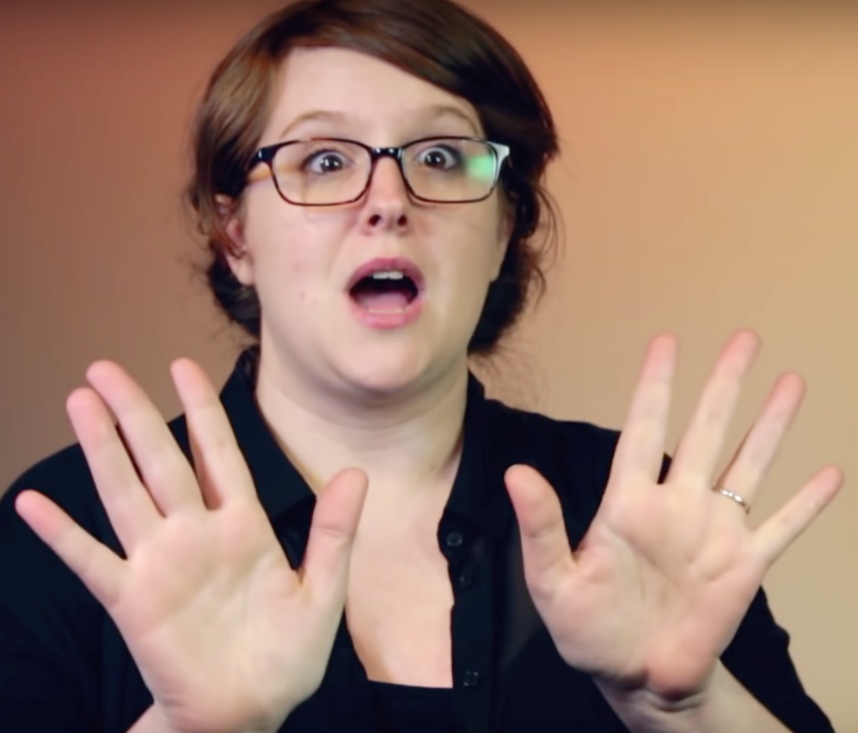
What does this emoji mean
Source – https://youtu.be/5JdVsbNqYno

Slide 8

What does this emoji mean
Source – https://media.giphy.com/media/BNKGM6uOgPhp6/giphy.gif

Slide 9
What does this emoji mean
U+1F450 OPEN HANDS SIGN

Slide 10
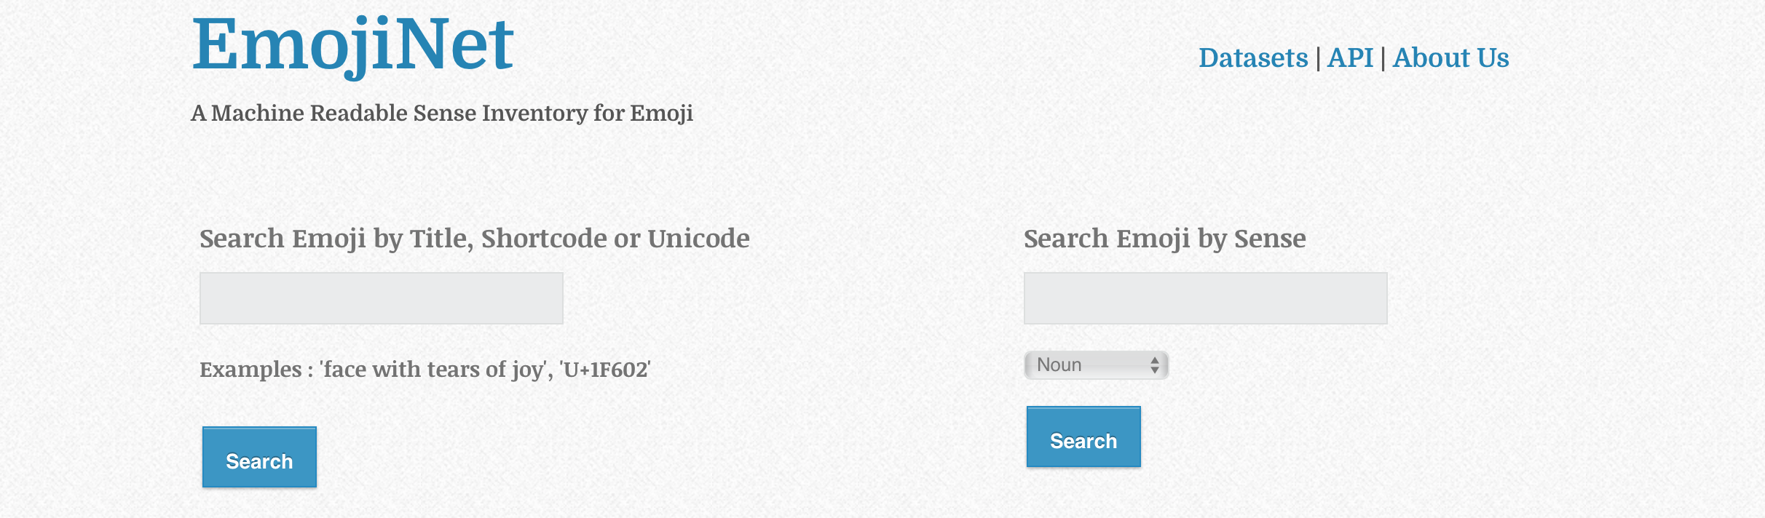

What is EmojiNet
A dataset of emoji meanings and interpretations
Almost 13,000 senses: a word(pos_tag)pair conveying notional interpretations of an emoji and the part of speech tag of the interpretations
Includes many possible senses per emoji
Agglomerates data across open web resources, connects sense labels to sense definitions by WSD task supported by embedding models to BabelNet

Slide 11
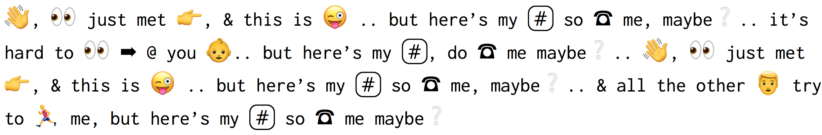



Why EmojiNet
Emoji is ambiguous – often, emoji are filtered, or otherwise not considered in NLP tasks on CMC
EmojiNet offers a source of emoji meanings and context towards emoji disambiguation
Goal: Support NLP, social media, CMC work trying to extract meaning from emoji-laden (short) text
Source – https://goo.gl/rjS1hX

Slide 12


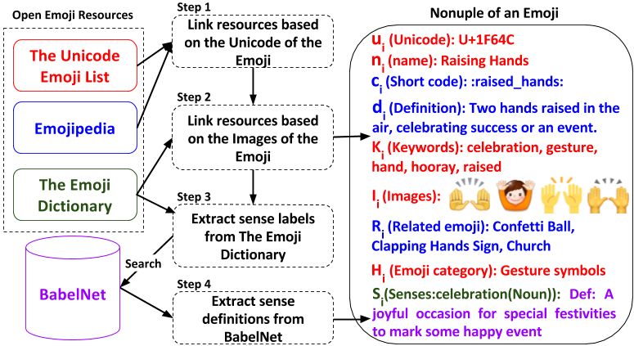
Building EmojiNet

Slide 13


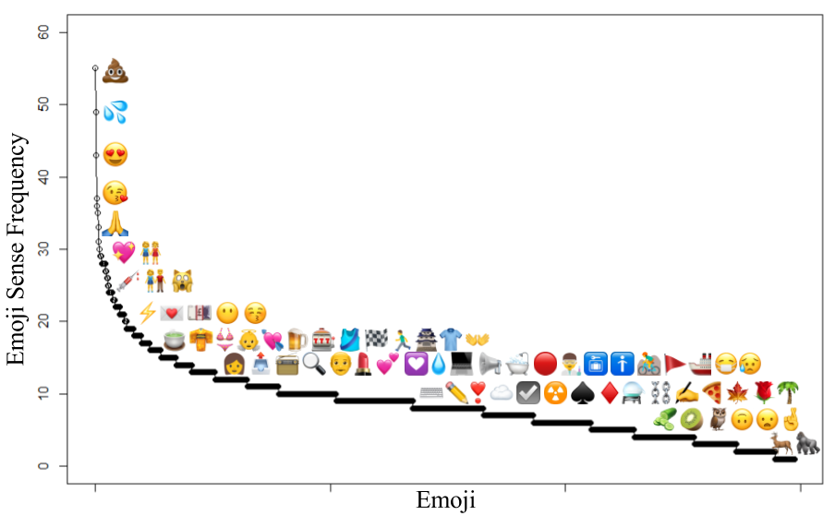
EmojiNet Sense Queries
Emoji Sense Distribution

Slide 14
EmojiNet Sense Queries
icing(noun)
pudding(noun)
stink(verb)
crappy(adjective)
Emoji Sense Distribution

Slide 15
EmojiNet Sense Queries
cutie(noun)
infatuation(noun)
hug(verb)
flirty(adjective)
Emoji Sense Distribution

Slide 16
EmojiNet Sense Queries
fashion(noun)
girl(noun)
wearing(verb)
female(adjective)
Emoji Sense Distribution

Slide 17


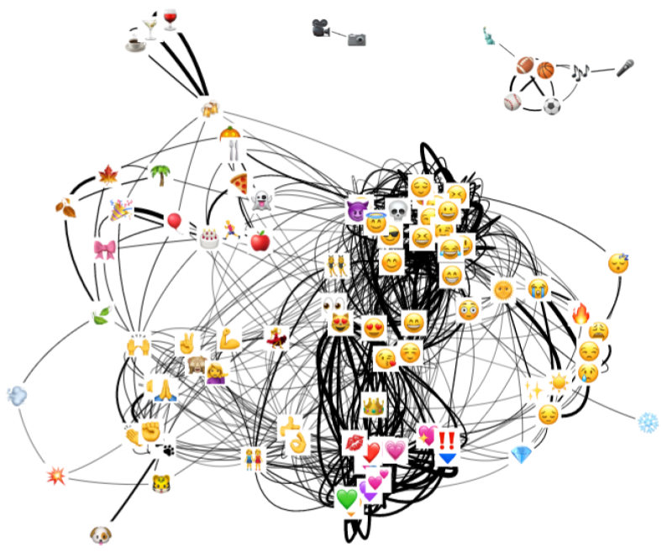










Example Application –
Emoji Similarity
Emoji Similarity – Similar Emoji Form Clusters
Jaccard Similarity of Emoji Based on
Emoji Sense Labels
Emoji Pair | Similarity
 | 0.60
 | 0.57
 | 0.56
 | 0.52
 | 0.52
 | 0.50
 | 0.50
 | 0.50
 | 0.48
 | 0.47

Slide 18

EmojiNet Dataset and REST API
The dataset is available for use/download in many formats
Browse the Dataset – http://emojinet.knoesis.org/
Download as flat files, Platform-specific emoji meanings, Emoji Similarity Datasets available at – http://emojinet.knoesis.org/datasets.php
Programmatically Access EmojiNet via a REST API, Documentation, Sample API Requests and JSON Responses available at – http://emojinet.knoesis.org/api.php

Slide 19


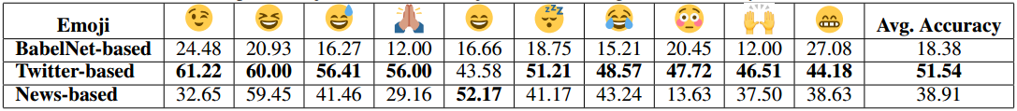
Applications of EmojiNet – Emoji Sense Disambiguation
We selected 25 most commonly misunderstood emoji and selected 50 tweets for each emoji
Used Simplified LESK algorithm for disambiguation
Context words were learned for each emoji sense definition using Twitter and Google News-based word embedding models
Twitter-based embeddings outperform others
Top 10 Emoji based on the Emoji Sense Disambiguation Accuracy (in % values)

Slide 20



Thank You! Visit us at http://emojinet.knoesis.org/
derek@knoesis.org
http://knoesis.org/people/derek/

Slide 21



Acknowledgement
We are grateful to Nicole Selken, the designer of The Emoji Dictionary and Jeremy Burge, the founder of Emojipedia for giving us the permission to use their web resources for our research. We are thankful to Scott Duberstein for helping us with setting up Amazon Mechanical Turk tasks. We acknowledge partial support from the National Science Foundation (NSF) award: CNS-1513721: “Context-Aware Harassment Detection on Social Media”, the National Institute on Drug Abuse (NIDA) Grant No. 5R01DA039454- 02: “Trending: Social Media Analysis to Monitor Cannabis and Synthetic Cannabinoid Use” and the National Institutes of Mental Health (NIMH) award: 1R01MH105384-01A1: “Modeling Social Behavior for Healthcare Utilization in Depression”. Points of view or opinions in this document are those of the authors and do not necessarily represent the official position or policies of the NSF, NIDA, or NIMH.

